Slide 1
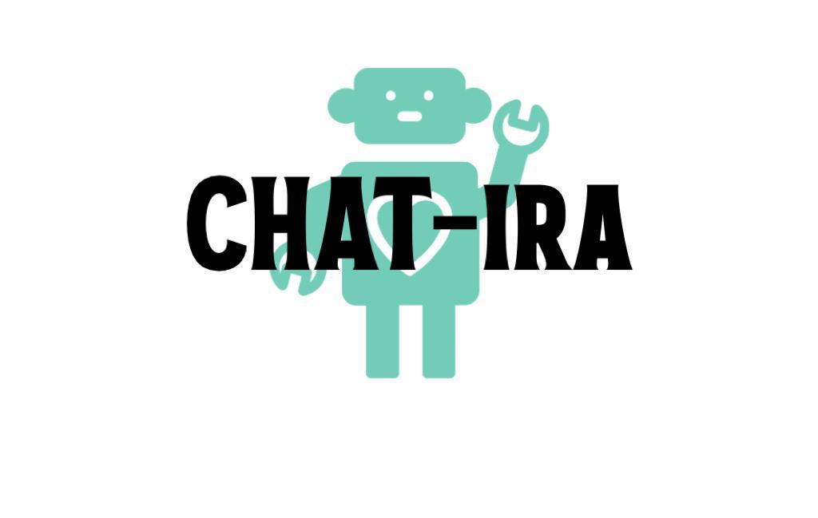
Mustangs Chatbot
Team Members:
Soundarya Boyeena
(proposal team leader – Iteration 2)
Naga Prashanth Sunkari
Varshith Basani

Slide 2
Current Business Situation:
The size of the world's chatbot market, estimated at 525.7 USD million in 2021, is projected to increase at a compound annual growth rate (CAGR) of 25.7% from 2022 to 2030.
Many product-based companies use a “Call Center” Chatbots to resolve FAQ’s. Example – Microsoft.
In Fashion Industry, Chatbots analyze customer preferences and present customized goods and services. Example – Tommy Hilfiger.
Chatbots are increasingly being connected with voice assistants such as Alexa and Google Assistant, allowing customers to interact with businesses via voice commands.

Slide 3
Our Business Goal:
Have our application included into the current university portal so that present and prospective students can use it to find answers to their questions.

Slide 4
WishList:
Personal Student Tutoring: Via Virtual Assistant. This is our future scope.
Mindfulness Virtual Coach: Students who are under pressure from homework and exams need a coach to help them learn how to calm.

Slide 5
WishList:
Instead of using a third-party service like Handshake to find job openings, we could build the functionalities within our chatbot.
The application should have some ways to configure the application settings (continuously updating the user queries).

Slide 6
Identifying Needs:
The system should accept information from the keyboard.
The system should be a personal assistant to answer the question of the user.
The system should be cost effective as we are using free and open-source software’s.

Slide 7
Identifying Needs:
The system should be accessible 24/7 to answer the queries of the users.
The system should be able to support many users; unlike humans, it won't get tired after a few chats.
The system should be compatible with currently existing system (MSU website portal).

Slide 8
Functional & Non-Functional Requirements

Slide 9
Functional & Non Functional Requirements:
A functional requirement describes what a software system should do, while NON-functional requirements place constraints on how the system will do so.
The functional requirement describes the behavior of the system as it relates to the system’s functionality. The non-functional requirement elaborates a performance characteristic of the system.

Slide 10
Functional Requirements:
Integrate with LMS.
Natural Language Processing.
Contextual Awareness.
Machine learning.
Others.

Slide 11
F.R-1: Integrate with LMS
The system shall be able to integrate with a Learning Management System to provide a seamless learning experience.
This will allow the chatbot to track the user's progress and provide recommendations based on their performance.

Slide 12
F.R-2: Natural Language Processing
The system shall use Natural Language Processing(NLP) to understand the user queries.
The chatbot should be able to comprehend conversational language and respond accordingly.

Slide 13
F.R-3: Contextual Awareness:
The system shall use Contextual Awareness to understand the user perspective.
Contextual awareness refers to the chatbot's ability to understand the user's situation, preferences, and needs, and respond accordingly.

Slide 14
F.R-4: Machine Learning
The system shall use a Machine Learning Algorithms to predict the user's future learning needs and provide personalized recommendations and support.

Slide 15
F.R-5: Others
The system shall –
accept input from the keyboard.
display the query and response in the window designed.
Shall have a user interface window which can be minimized.

Slide 16
Non-Functional Requirements:
Reliability.
Usability.
Maintainability.

Slide 17
N.R-1: Reliability
The chatbot should be always available and responsive. Without crashing or experiencing downtime, it need to be able to handle a huge number of users.
It is classified as non-functional requirement as it is associated with the performance of the system.

Slide 18
N.R-2: Usability
The chatbot must be simple for students to interact with and navigate, with a user-friendly interface.
It is classified as non-functional requirement as it is associated with the performance of the system.

Slide 19
N.R-3: Maintainability
The chatbot should be simple to update and maintain. The chatbot should be modular, and changes to one module shouldn't have an impact on other functions.
It is classified as non-functional requirement as it is associated with the performance of the system.

Slide 20
Constraints

Slide 21
Constraints:
The program shall be designed with modern OOP standards.
The software shall be used for MSU Only.

Slide 22
Constraints:
The software shall be developed in C++/ Python.
The software shall have some performance issues.

Slide 23
C1 - OOP:
It is a functional Constraint.
Our system shall utilize class inheritance, association and aggregation relationships.

Slide 24
C2 - Software use:
It is a Functional Constraint.
Although this system is scalable to other universities, it is only applicable to MSU.

Slide 25
C3 - Python:
It is a Functional Constraint.
The program is written in Python.
Given a choice between Python and C++ by the Professor.

Slide 26
C4 - System Performance:
It is a Non – Functional Constraint.
Based on the data given, there may be performance issues. Sometimes it may give inaccurate information.

Slide 27
Information Techniques

Slide 28
Information Techniques:
Writing User Stories.
User Interviewing.

Slide 29

Writing User Stories:
https://www.researchgate.net/publication/340357921_User_stories_collection_via_interactive_chatbot_to_support_requirements_gathering
The above link shows how chatbot is implemented.
We collected user complaints regarding the chatbots
and finding the resolution for them.

Slide 30

User Interviewing:
We have virtually interviewed 5 students who
currently wish to do their Master’s in
United states.
Out of 5, 4 students expressed their wish to have
chatbots to the university websites were
they can access data regarding their queries.
Many of them said that searching for
information in the portal was
time consuming.
We even visited GEO office, to understand the
perspective of upcoming students regarding
their queries about the university.

Slide 31
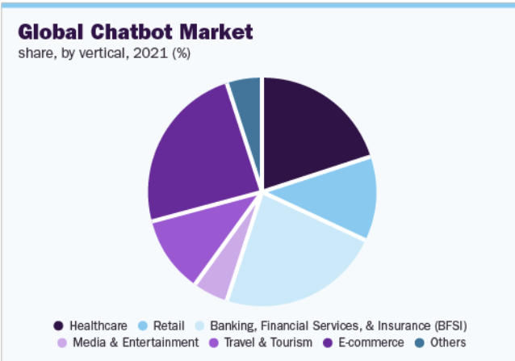
General Business:
Educational Chatbots.
The economy for chatbots was estimated
to be worth USD 525.7 million in 2021,
and from 2022 to 2030, it is expected
to grow at a compound annual growth
rate (CAGR) of 25.7%.
Most of the Business domains are adapting
chatbots to reduce cost and time for
customer services. Examples are
Microsoft’s BING AI, Google’s MEENA,
Facebook’s BLENDER BOT and so on…
Chatbots operate by collecting input from the user,
interpreting the user's intent, and then creating and
delivering the response to the user.

Slide 32
System Environment:
Our environment is on Windows and IOS Applications.
Chatbots in general has wide variety of environments:
1. Web
2. Windows systems
3. IOS systems
4. Mobile devices like Android and Apple.
Chatbots are used in most of the business-like Finance, Banking, Health care, Education etc.

Slide 33
Existing Business Process:
The current business process for most of the chatbots is Open-Source.
They are primarily Web Applications adapted by most of the business processes.
The input and output of the chatbot will be text based.
The users give the input to the chatbot in the form of questions and the chatbot responds to the questions with the desired output.
Modern chatbots resemble the conversation between a user and a human representative by using AI/ML and natural language processing.

Slide 34
Problems with current systems:
Chatbots are still unable to understand the context of a conversation. They rely on pre-programmed algorithms, which limits their understanding of the conversation.
Chatbots are not yet capable of handling complex enquiries. Users may find it aggravating as they frequently give generic answers to challenging questions.
Chatbots have a limited vocabulary and cannot understand or respond to complicated language such as sarcasm or humor. They find it difficult to respond with precision because of this.

Slide 35
Product Goals:
Chatbots can be used anywhere and everywhere. The goal of our product is to create a well performed chatbot with precision.
This chatbot will be helpful to students who are currently aspiring to join the MSU and want to know information about the university.

Slide 36
Users of our system:
Current Users:
1. Upcoming Students.
2. Current Students.
3. Parents.
4. Faculty.
5. University Staff.
Future Users:
1. Anyone who wants to search for information about the college.

Slide 37
User Wants:
The user wants the chatbot to give precise answers for the questions asked.
The user aims that the chatbot are available 24/7 to communicate.
The user wants the chatbot give updates time to time.

Slide 38
Chatbot Considerations:
The below are the considerations in accordance with the system:
Quality: The chatbot uses NLP model to understand the questions and give accurate answers. The quality of the system will not be compromised and aim for more precision.
Performance: The product shall give the response to the queries in less than 2 seconds. The response will be displayed within the window size chosen.
Security: As of now, the product has no security requirements because there are no clear threats created by the project's use, creation, or distribution.

Slide 39
Business Domain Model - Education
Education is our domain.
The user asks questions about university related and the bot answers the questions.
Globally, consulting firm Juniper Research predicts that the chatbot industry will be worth $142 billion by 2024.

Slide 40
Business Domain- Information Collection
Writing user stories and user interviewing the two information techniques which helped to collect information about the domain.

Slide 41
Brainstorming Process:
System application can have multiple users.
application - noun implies class or attribute (class)
System - numeric implies multiplicity (exactly one)
can have multiple - numeric implies multiplicity (0 to many)
users - noun implies class or attribute
have - possession implies aggregation.

Slide 42
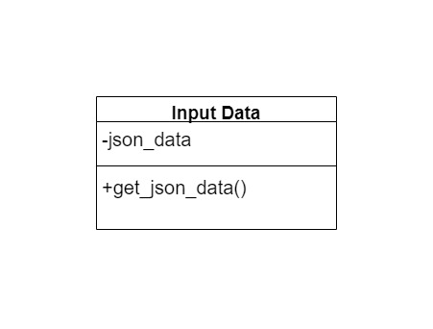
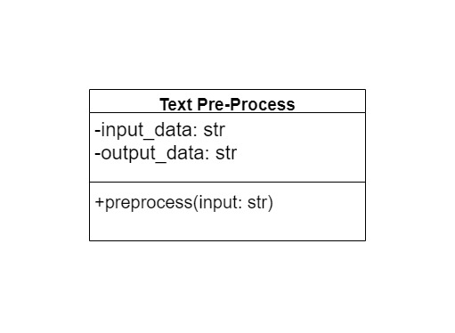
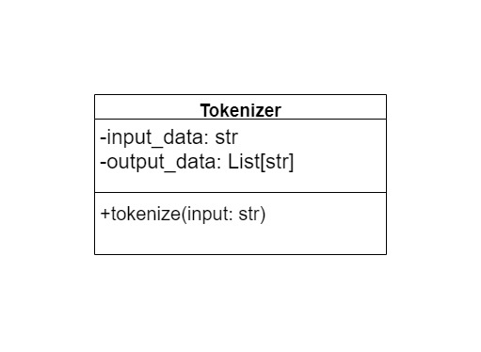
Classes:
Text Pre-Process Class
Tokenizer class
Input Data Class

Slide 43
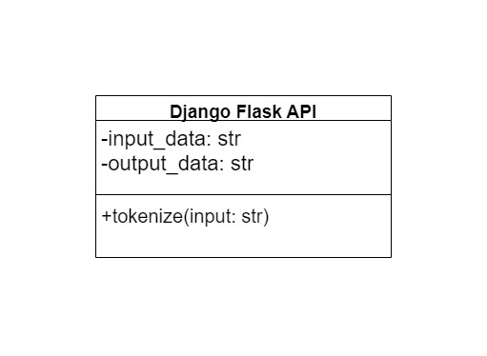
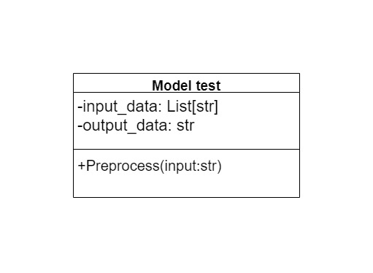

Classes:
Django Flask API Class
Model test Class
ANN Model

Slide 44
Attributes:
InputData
Attributes:
json_data: str
Methods:
get_json_data(): returns the JSON data as a string
TextPreProcess
Attributes:
input_data: str
output_data: str
Methods:
preprocess(input: str): takes a string input, performs noise removal using NLTK, and returns the pre-processed string

Slide 45
Attributes:
Tokenizer
Attributes:
input_data: str
output_data: List[str]
Methods:
tokenize(input: str): takes a string input and returns a list of tokens
ANN Model
Attributes:
input_data: List[str]
output_data: str
Methods:
train_model(input: List[str]): trains the ANN model on the tokenized input datapredict(input: List[str]): takes a list of tokens as input and returns the output response

Slide 46
Attributes:
Model Test
Attributes:
input_data: List[str]
output_data: str
Methods:
evaluate_model(input: List[str]): takes a list of tokens as input, tests the ANN model's performance on the input, and returns the output response
DjangoFlaskAPI
Attributes:
input_data: str
output_data: str
Methods:
run_server(): runs the web API on a local host and listens for incoming user questions, returning the appropriate response generated by the ANN model.

Slide 47
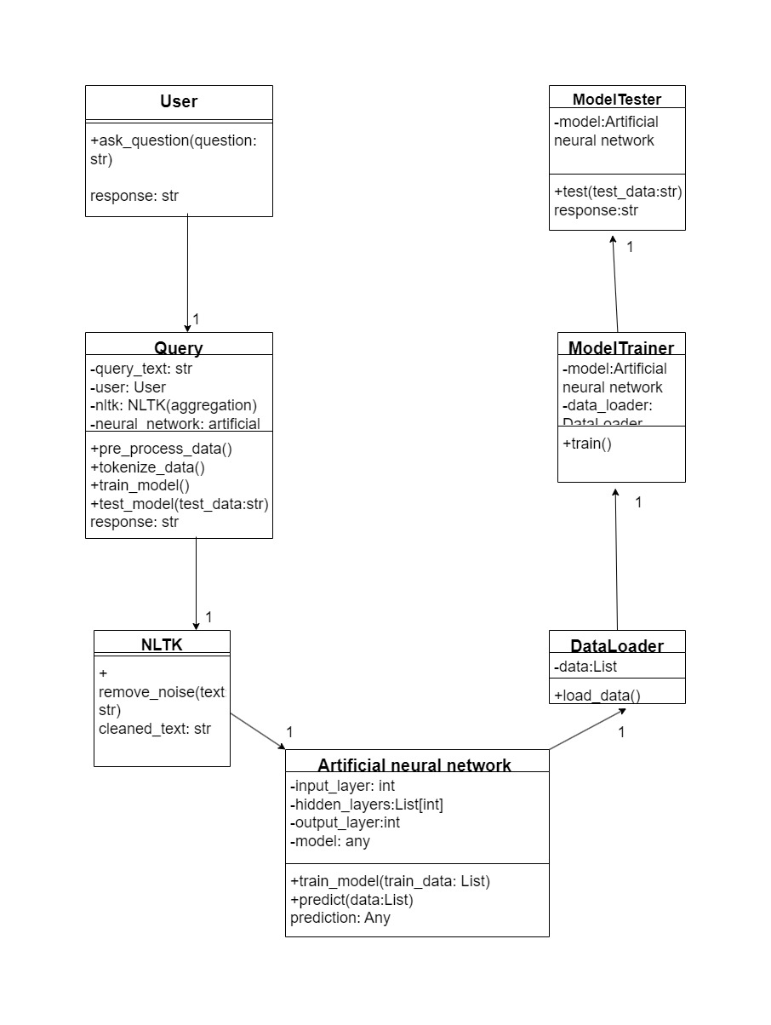
Association:
The classes have one to one
relationship in between them.
NLTK is also known as
Preprocessing.

Slide 48
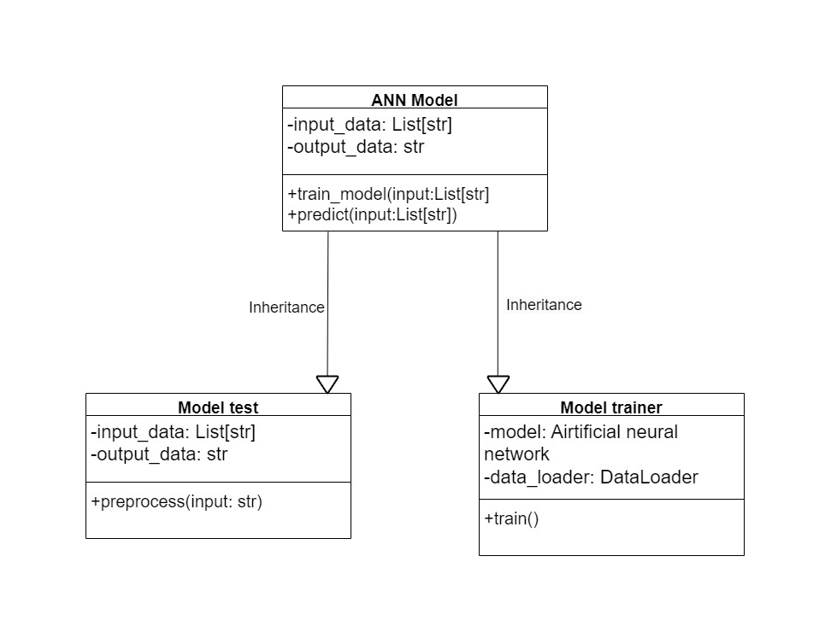
Inheritance:
The ModelTrainer and
ModelTester classes both
have a model attribute
that is an instance of the
Artificial Neural Network class,
indicating that they
are both subclasses
of the Artificial Neural
Network class.

Slide 49
Aggregation:
The Query class now aggregates the NLTK class and the Artificial Neural Network class, represented by the diamond shape with a black diamond head. This indicates that Query class contains instances of both classes as its attributes.
Similarly, the ModelTrainer class aggregates the DataLoader class, represented by the diamond shape with a white diamond head. This indicates that ModelTrainer class contains an instance of DataLoader as its attribute.

Slide 50
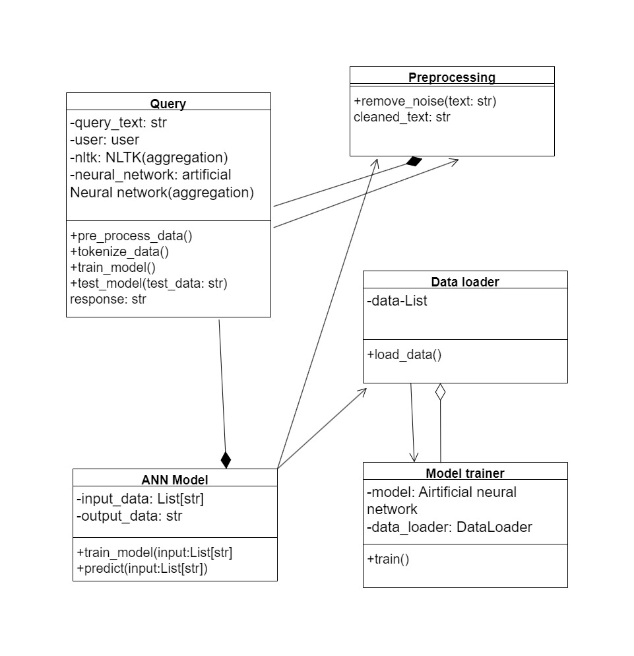
Aggregation:

Slide 51
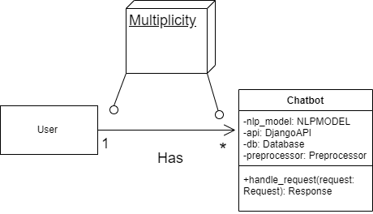
Multiplicity:
One chatbot has zero or more users and every user has exactly one Chatbot.

Slide 52
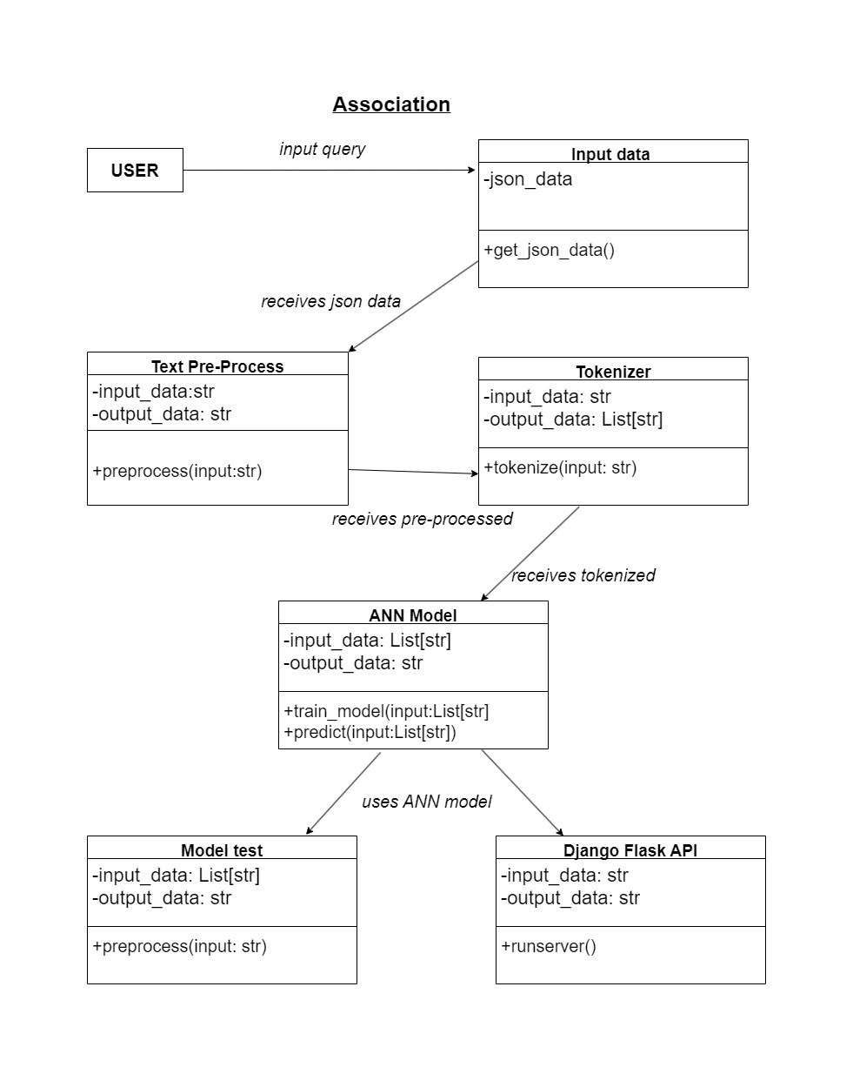
Association Partial Diagram:

Slide 53
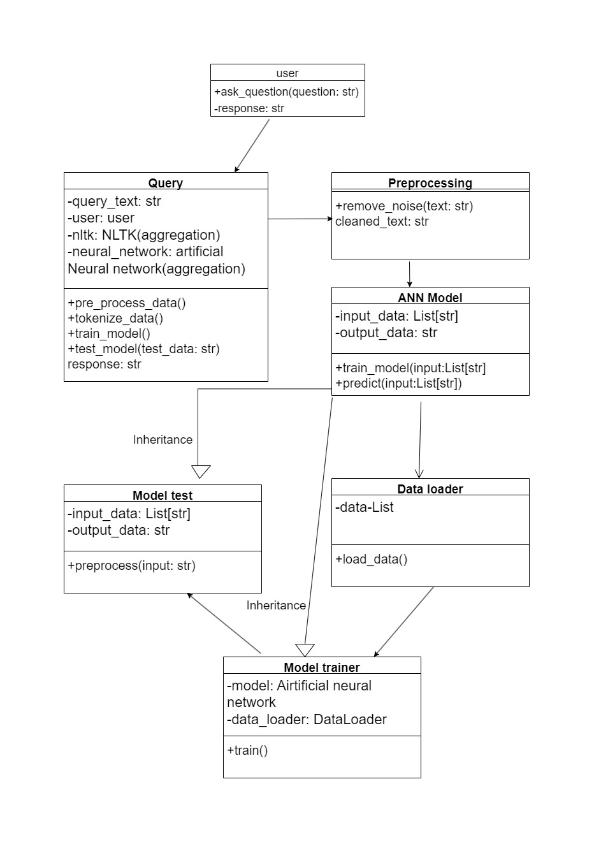
Inheritance Partial Diagram :

Slide 54
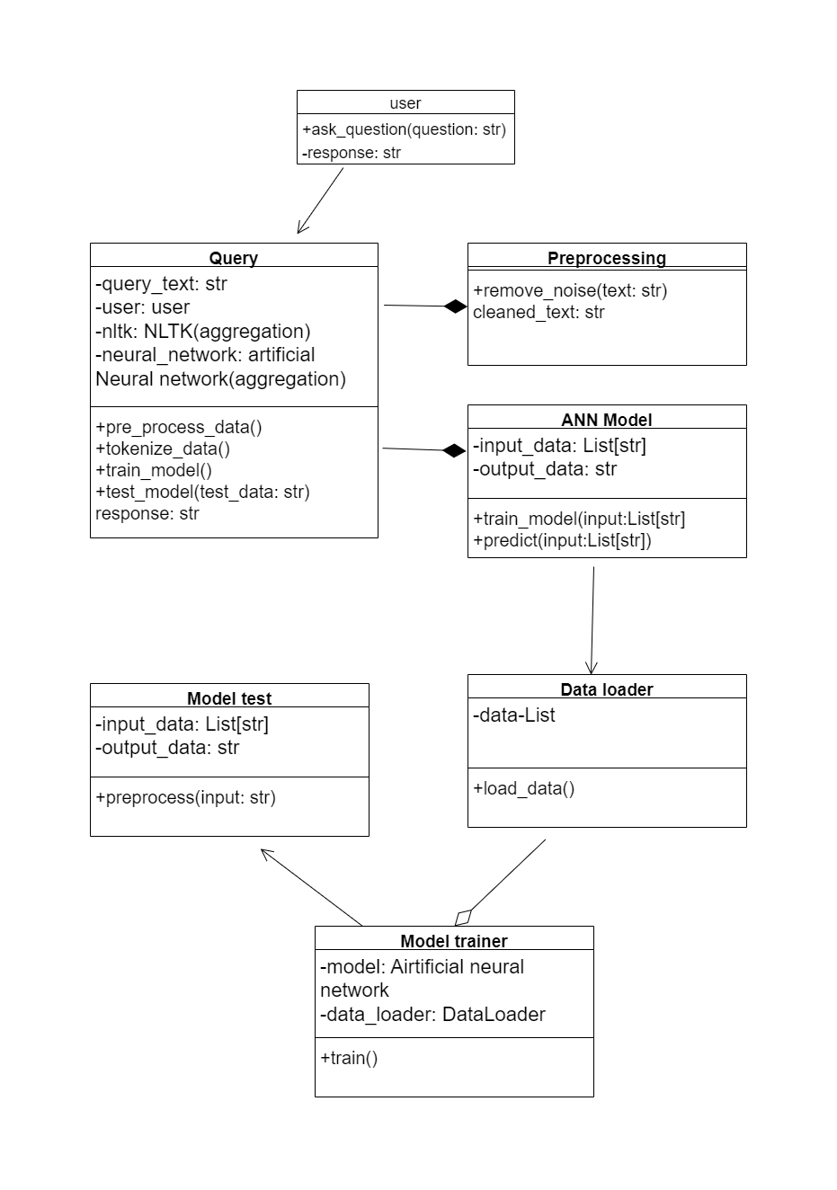
Aggregation Partial Diagram :
inheritance

Slide 55
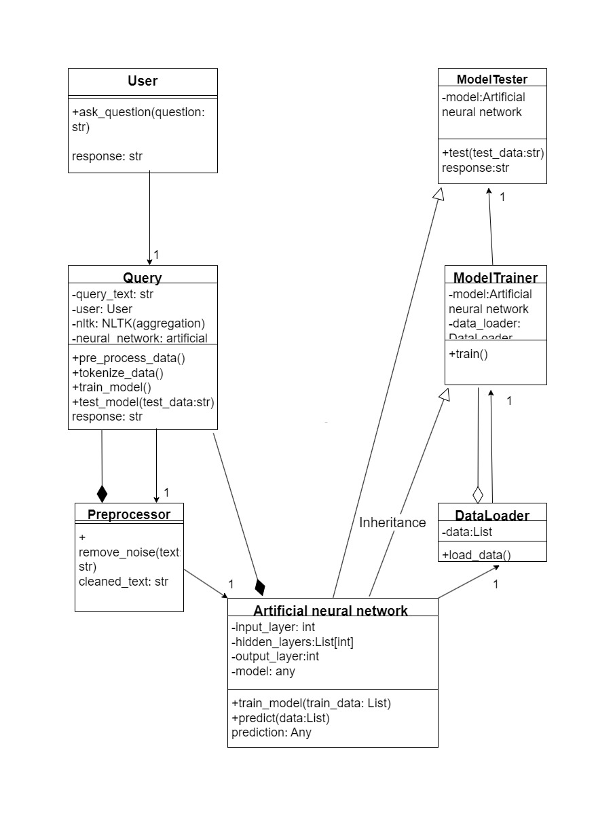
Full Sample Domain Model :

Slide 56
Team Member Work Accomplished:
Soundarya Boyeena (Proposed Team Leader – Iteration 2)
1.Team lead, organizing the requirements for the presentation.
2. Weekly team meetings with planned and agreed agendas.
3. Divide the job among the team members.
4. Obtaining software requirement specifications and organizing a group presentation practice.

Slide 57
Team Member Work Accomplished:
Naga Prashanth Sunkari
1.Produced the initial UML rough diagrams.
2. Prepared the sample data from the university portal.
3. Prepared Feasibility Report.

Slide 58
Team Member Work Accomplished:
Varshith Basani
1. Creating the UML using Draw.io and transcribing it into the presentation slide in accordance with the guidelines supplied for the slide format. U
2. Prepared the Abstract.
3. Documented the code with the video.

Slide 59
Schedule Update:
Finished learning almost all necessary concepts related to chatbot.
Will be updating the Training Json data file with more samples.
Implementing UI will be done by March 31st.
Model will be trained to get the precision by March 31st.

Slide 60
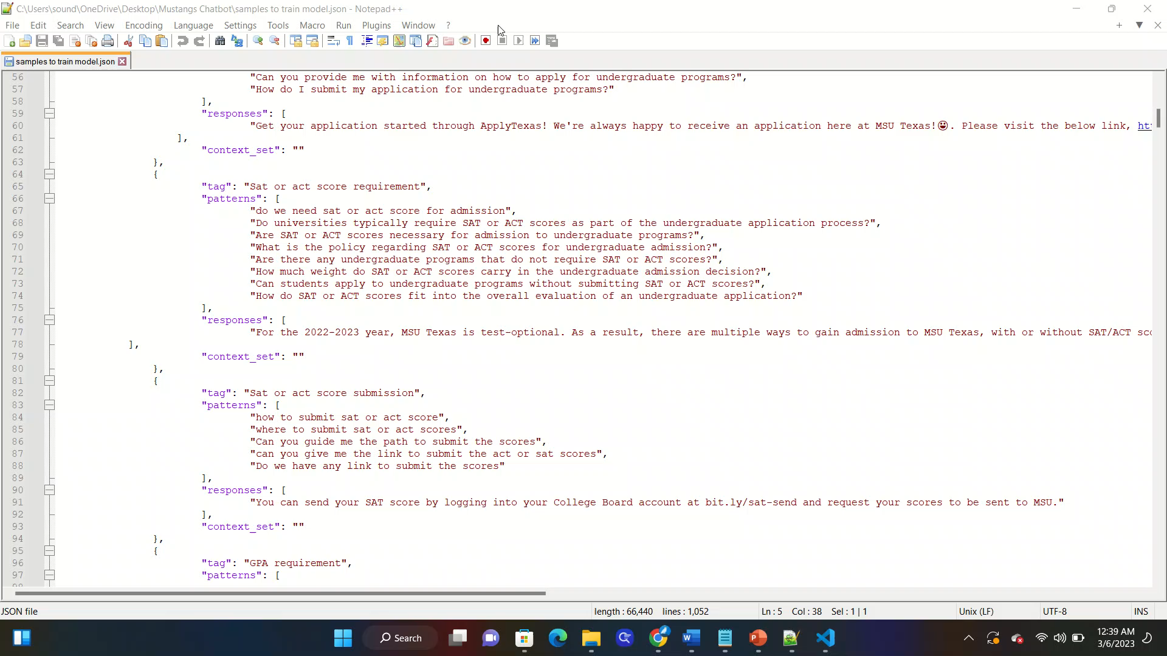
Project Demo:

Slide 61
Project Demo:
https://www.youtube.com/watch?v=YD2yLui77P4

Slide 62
Additional Documents:
Feasibility Study:
https://github.com/Boyeenas/CMPS-5153-Adv-Software-Engineering/blob/59cc524b90317e29c2f015dbe03e248ce4e2c685/FEASIBILITY%20STUDY%20OF%20MUSTANG.docx
SRS Document:
https://github.com/Boyeenas/CMPS-5153-Adv-Software-Engineering/blob/59cc524b90317e29c2f015dbe03e248ce4e2c685/Chatbot%20SRS.doc

Slide 63
Questions ?

Slide 64
Thankyou!!!!!

